Slide 1
Window Form Application
Created by: M.Siddique

Slide 2
Outlines
Introduction
Creating a Window Form App
Main Components in Window Form
Window Form Controls
The Anatomy of a Form
Event Handing
3 Projects

Slide 3
Introduction
Window Form:
Windows Forms is a Graphical User Interface(GUI) class library which is bundled in .Net Framework.
Its main purpose is to provide an easier interface to develop the applications for desktop, tablet,
PCs.
It provides one of the most productive ways to create desktop apps based on the visual designer
provided in Visual Studio.

Slide 4
Continue..
Form is a container which can hold all other controls within it.
In C# .NET every for is treated as a class and is derived from System.Windows.Forms.Form class.
In C# .NET Window Form we can place various controls like Text Box, Button, Check Box, Radio Buttons etc.
In C# .NET every Win Forms application every control has a special class and is present in System.Windows.Forms namespace.

Slide 5
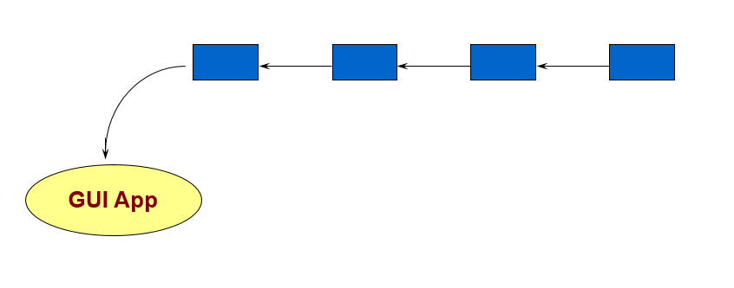
Continue..
Event-driven application
Idea is very simple:
individual user actions are translated into “events”
events are passed, 1 by 1, to application for processing
-this is how most GUIs are programmed…

Slide 6
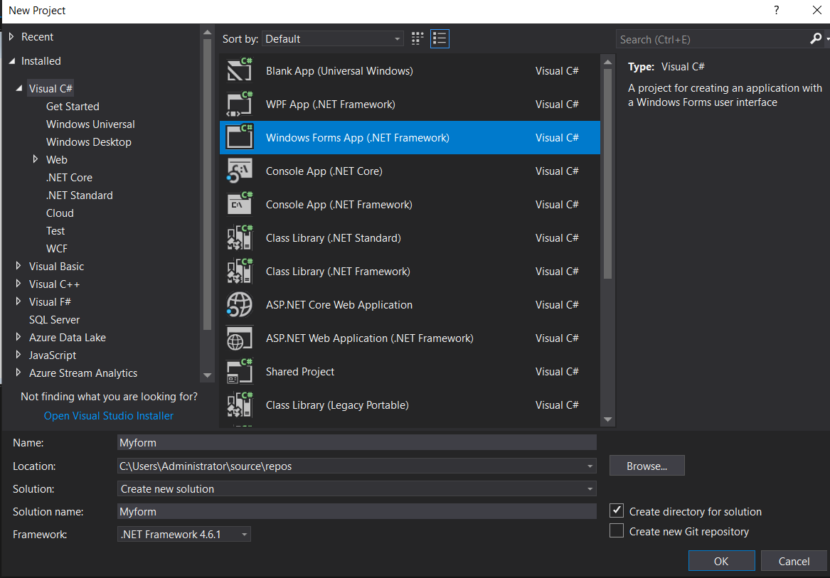
Create a Window Form app
Open Visual Studio.
Select Create a new project.
Select Window form App option.
Set project name and location and than press
ok button to create a project.

Slide 7
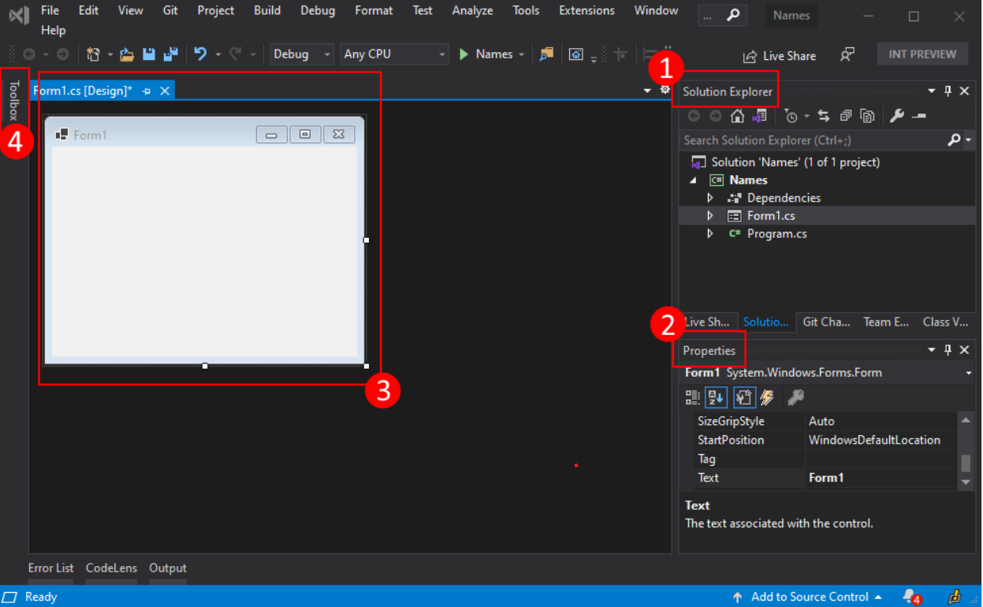
Main Components

Slide 8
Main Components
Support for Windows Forms in Visual Studio has four important components that you'll interact with as you create an app:
1. Solution Explorer: All of your project files, code, forms, resources, will appear in this pane.
2. Properties: This pane shows property settings you can configure based on the item selected or
you can Customize your tool or component.
For example, if you select an item from Solution Explorer, you'll see property settings related to the file. If you select an object in the Designer, you'll see settings for the control or form.

Slide 9
Continue..
3. Form Designer: This is the designer for the form. It's interactive and you can drag-and-drop objects from the Toolbox. By selecting and moving items in the designer, you can visually compose the user interface (UI) for your app.
4: Toolbox: The toolbox contains all of the controls such a label, button, textbox and much more you can add to a form. To add a control to the current form, double-click a control or drag-and-drop the control.

Slide 10
Simple Window Form Application:
New with Visual Studio 2005, the IDE separates the source code into three separate files
Form1.cs: Normally this is the only one you edit
Form1.Designer.cs: Holds the auto-generated code
Program.cs: Contains the Main( ) method, where execution always begins
Form1.cs and Form1.Designer.cs both include partial class definitions for the Form1 class

Slide 11
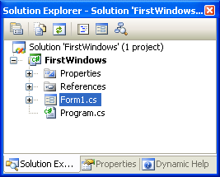
Solution Explorer Window:
Expand Form1.cs node to reveal the Form1.Designer.cs file

Slide 12
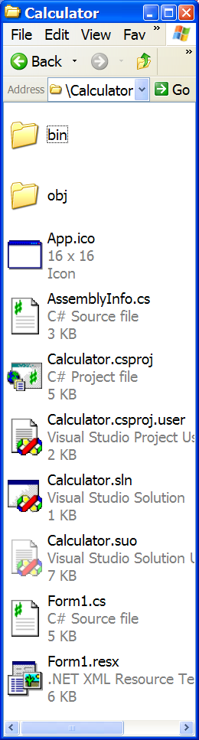
Working with visual Studio:
In Visual Studio, you work in terms of source files, projects & solutions
Source files contain code
end in .cs, .vb, etc.
Project files represent 1 assembly
used by VS to keep track of source files
all source files must be in the same language
end in .csproj, .vbproj, etc.
Solution (*.sln) files keep track of projects
so you can work on multiple projects

Slide 13
Imp Window Form Properties
Name | Description
BackColor | Overridden.
BackgroundImage | Gets or sets the background image displayed in the control
CancelButton | Gets or sets the button control that is clicked when the user presses the ESC key.
Enabled | Gets or sets a value indicating whether the control can respond to user interaction.(Inherited from Control.)
Font | Gets or sets the font of the text displayed by the control.(Inherited from Control.)
ForeColor | Gets or sets the foreground color of the control.(Inherited from Control.)
FormBorderStyle | Gets or sets the border style of the form.
Height | Gets or sets the height of the control.(Inherited from Control.)
Icon | Gets or sets the icon for the form.
Left | Gets or sets the distance, in pixels, between the left edge of the control and the left edge of its container's client area.(Inherited from Control.)
MaximizeBox | Gets or sets a value indicating whether the Maximize button is displayed in the caption bar of the form.

Slide 14
Imp Window Form Properties
Name | Description
MaximumSize | Overridden. Gets the maximum size the form can be resized to.
MinimizeBox | Gets or sets a value indicating whether the Minimize button is displayed in the caption bar of the form.
MinimumSize | Overridden. Gets or sets the minimum size the form can be resized to.
Name | Gets or sets the name of the control.
Size | Gets or sets the size of the form.
StartPosition | Gets or sets the starting position of the form at run time.
Tag | Gets or sets the object that contains data about the control.
Text | Display Text .
Visible | Gets or sets a value indicating whether the control is displayed
Width | Gets or sets the width of the control
WindowState | Gets or sets the form's window state.
Form1 form;
form = new Form1();
form.WindowState = FormWindowState.Maximized;
form.Show();

Slide 15
Window Form Controls:
Controls are all classes
Button, Label, TextBox, ComboBox, MainMenu, ListBox, CheckBox, RadioButton, and MonthCalendar
Each comes with its own predefined properties and methods
Each fires events
Each is derived from the System.Windows.Forms.Control class

Slide 16
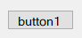
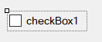
Window Form Controls:
Button
Use: Fires an event when a mouse click occurs or the Enter or Esc key is pressed.
Description: Represents a button on a form. Its text property determines the caption displayed on the button’s surface.
CheckBox
Use: Permits a user to select one or more options.
Description: Consists of a check box with text or an image beside it. The check box can also be represented as a button by setting: checkBox1.Appearance = Appearance. Button.

Slide 17
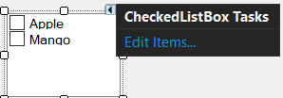
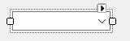
Window Form Controls:
CheckedListBox
Use: Displays list of items.
Description: ListBox with checkbox preceding each item in list.
ComboBox
Use: Provides TextBox and ListBox functionality.
Description: Hybrid control that consists of a textbox and a
drop-down list. It combines properties from both the TextBox
and the ListBox.

Slide 18
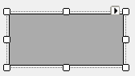
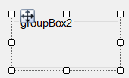
Window Form Controls:
DataGridView
Use: Manipulates data in a grid format.
Description: The DataGridView is the foremost control to represent relational data. It supports binding to a database. The DataGridView was introduced in .NET 2.0 and supersedes the DataGrid.
GroupBox
Use: Groups controls.
Description: Use primarily to group radio buttons; it places a border around the controls it contains.

Slide 19
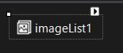
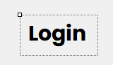
Window Form Controls:
ImageList
Use: Manages a collection of images.
Description: Container control that holds a collection of images used by other controls such as the ToolStrip, ListView, and TreeView.
Label
Use: Adds descriptive information to a form.
Description: Text that describes the contents of a control or instructions for using a control or form.

Slide 20
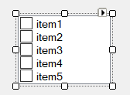
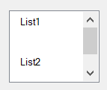
Window Form Controls:
ListBox
Use: Displays a list of items—one or more of which may be selected.
Description: May contain simple text or objects. Its methods, properties, and events allow items to be selected, modified, added, and sorted.
ListView
Use: Displays items and subitems.
Description: May take a grid format where each row represents a different item and sub-items. It also permits items to be displayed as icons.

Slide 21
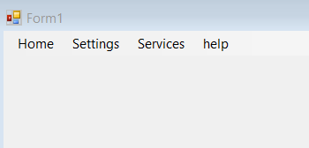
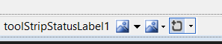
Window Form Controls:
MenuStrip
Use: Adds a menu to a form.
Description: Provides a menu and submenu system for a form. It supersedes the MainMenu control.
StatusStrip
Use: Provides a set of panels that indicate program status.
Description: Provides a status bar that is used to provide contextual status information about current form activities.

Slide 22
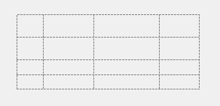
Window Form Controls:
Panel FlowPanelLayout TablePanelLayout
Use: Groups controls.
Description: A visible or invisible container that groups controls. Can be made scrollable. FlowPanelLayout automatically aligns controls vertically or horizontally.
TablePanelLayout aligns controls in a grid.

Slide 23
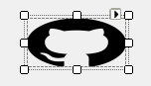
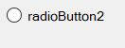
Window Form Controls:
PictureBox
Use: Contains a graphic.
Description: Used to hold images in a variety of standard formats. Properties enable images to be positioned and sized within control’s borders.
RadioButton
Use: Permits user to make one choice among a group of options.
Description: Represents a Windows radio button.

Slide 24
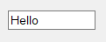
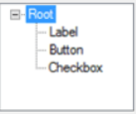
Window Form Controls:
TextBox
Use: Accepts user input.
Description: Can be designed to accept single- or multi-line input. Properties allow it to mask input for passwords, scroll, set letter casing automatically, and limit contents to read-only.
TreeView
Use: Displays data as nodes in a tree.
Description: Features include the ability to collapse or expand, add, remove, and copy nodes in a tree.

Slide 25
Window Form Controls:
ProgressBar
Use: Depicts an application’s progress.
Description: Displays the familiar progress bar that gives a user feedback regarding the progress of some event such as file copying.

Slide 26
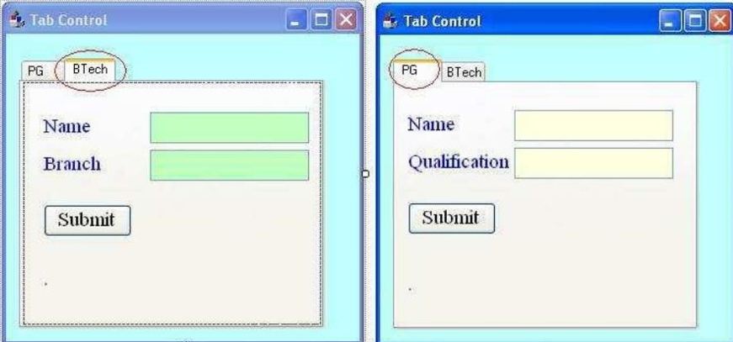
Window Form Controls:
Tab Control
This control is used to create required tab pages so that each tab page can contain required number of controls to group together.
Properties With TabControl Class:
TabPages Used to set or get the tab pages with in it the form of collection.
Example: ➔

Slide 27
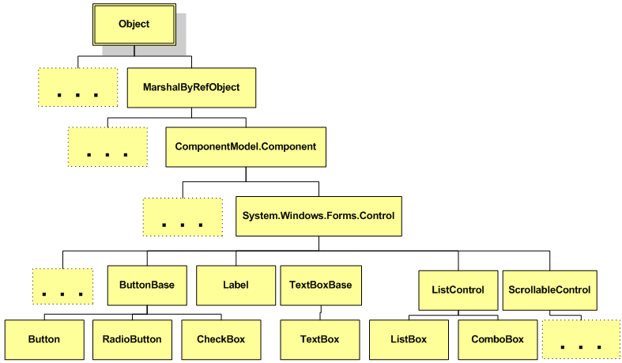
Continue..
Control Class Hierarchy:
Dots indicate other classes are derived from the class

Slide 28
Continue..
Two Ways to place controls on Form
From Toolbox, double-click on control or drag and drop
Move, resize, and delete controls
Format controls
Align controls
Make same size
Horizontal and vertical spacing

Slide 29
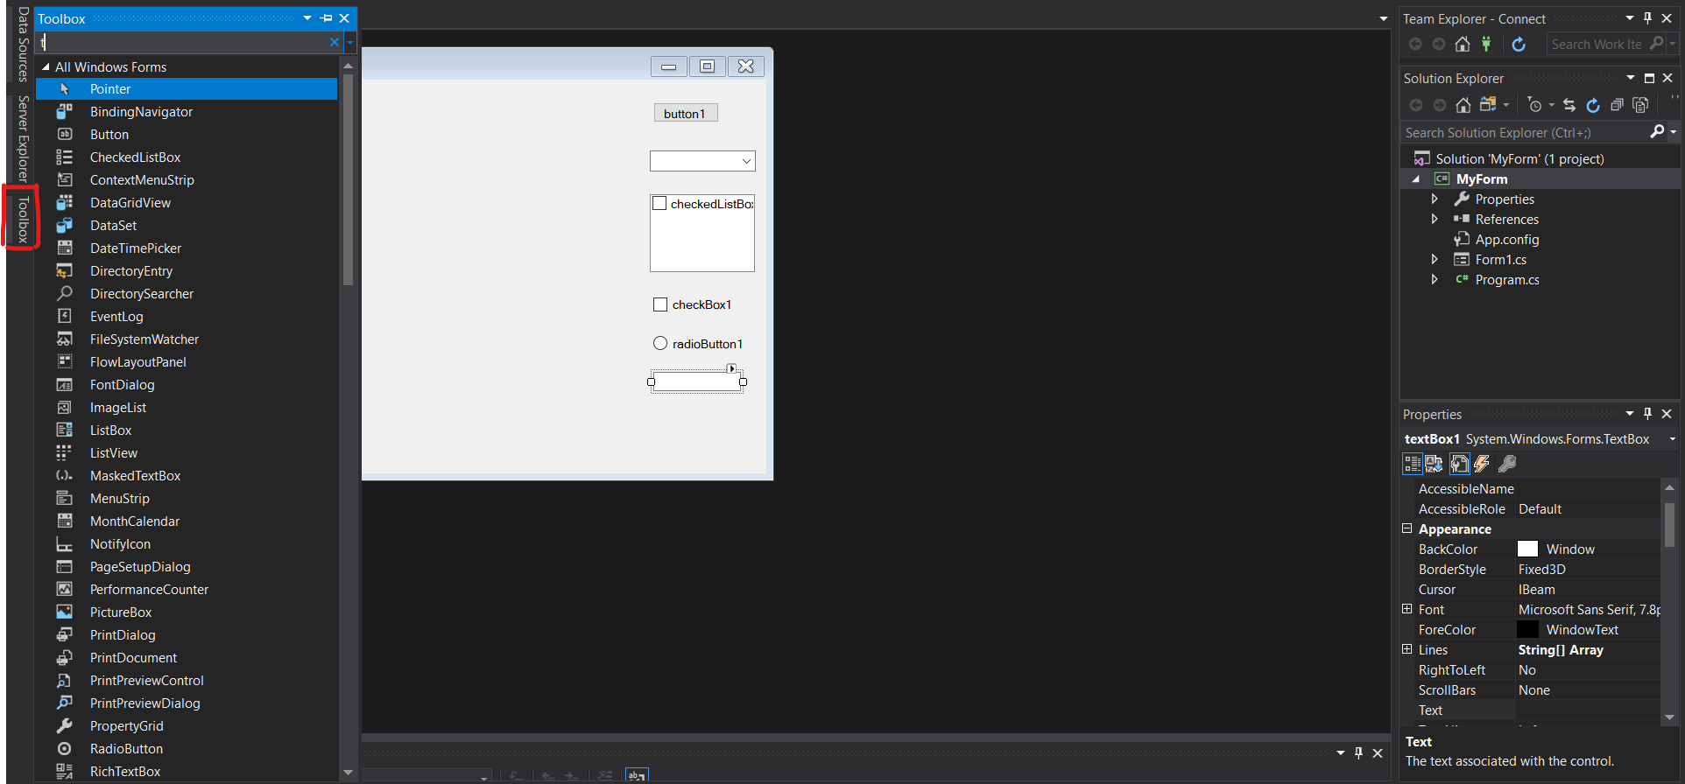
Continue…
You can simply drag and drop the component from toolbar like this.

Slide 30
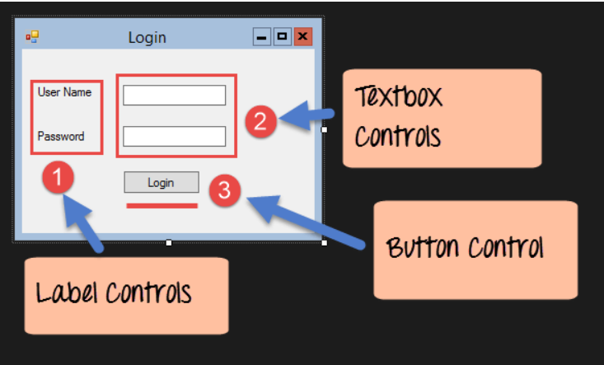

Slide 31
Common Properties of Form Controls
Name | Availability | Description
Anchor | Read/Write | Using this property, you can specify how the control behaves when its container is resized. See below for a detailed explanation of this property.
BackColor | Read/Write | The background color of a control.
Bottom | Read/Write | By setting this property, you specify the distance from the top of the window to the bottom of the control. This is not the same as specifying the height of the control.
Dock | Read/Write | Allows you to make a control dock to the edges of a window. See below for a more detailed explanation of this property.
Enabled | Read/Write | Setting Enabled to true usually means that the control can receive input from the user. Setting Enabled to false usually means that it cannot.
ForeColor | Read/Write | The foreground color of the control.
Height | Read/Write | The distance from the top to the bottom of the control.
Left | Read/Write | The left edge of the control relative to the left edge of the window.
Name | Read/Write | The name of the control. This name can be used to reference the control in code.
Image | Read/Write | Allow you to specify an image (bitmap, icon etc.), which will be displayed on the Control.

Slide 32
Common Properties of Form Controls
Name | Availability | Description
ImageAlign | Read/Write | With this property, you can set where the image on the Control should appear
Parent | Read/Write | The parent of the control.
Right | Read/Write | The right edge of the control relative to the left edge of the window.
TabIndex | Read/Write | The number the control has in the tab order of its container.
TabStop | Read/Write | Specifies whether the control can be accessed by the Tab key.
Tag | Read/Write | This value is usually not used by the control itself, and is there for you to store information about the control on the control itself. When this property is assigned a value through the Windows Form designer, you can only assign a string to it.
Top | Read/Write | The top edge of the control relative to the top of the window.
Visible | Read/Write | Specifies whether or not the control is visible at runtime.
Width | Read/Write | The width of the control.

Slide 33
Important point of Button Control:
When you think of a button, you are probably thinking of a rectangular button that can be clicked to perform some task .
However, technically there are three buttons in Visual Studio.NET. This is because radio buttons (as the name implies) and check boxes are also buttons. Because of this, the Button class is not derived directly from Control, but from another class called ButtonBase, which is derived from Control.
The button control exists on just about any Windows dialog you can think of. A button is primarily used to perform three kinds of tasks:
To close a dialog with a state (for example, OK and Cancel buttons)
To perform an action on data entered on a dialog (for example clicking Search after entering some search criteria)
To open another dialog or application (for example, Help buttons)

Slide 34
The Anatomy of a Form
In the world of Windows Forms, the Form type represents any window in the application, including the topmost main windows, child windows of a multiple document interface (MDI) application, as well as modal and modeless dialog boxes.
As Figure A-11 shows in next slide, the Form type gathers a good deal of functionality from its parent classes and the numerous interfaces it implements.

Slide 35
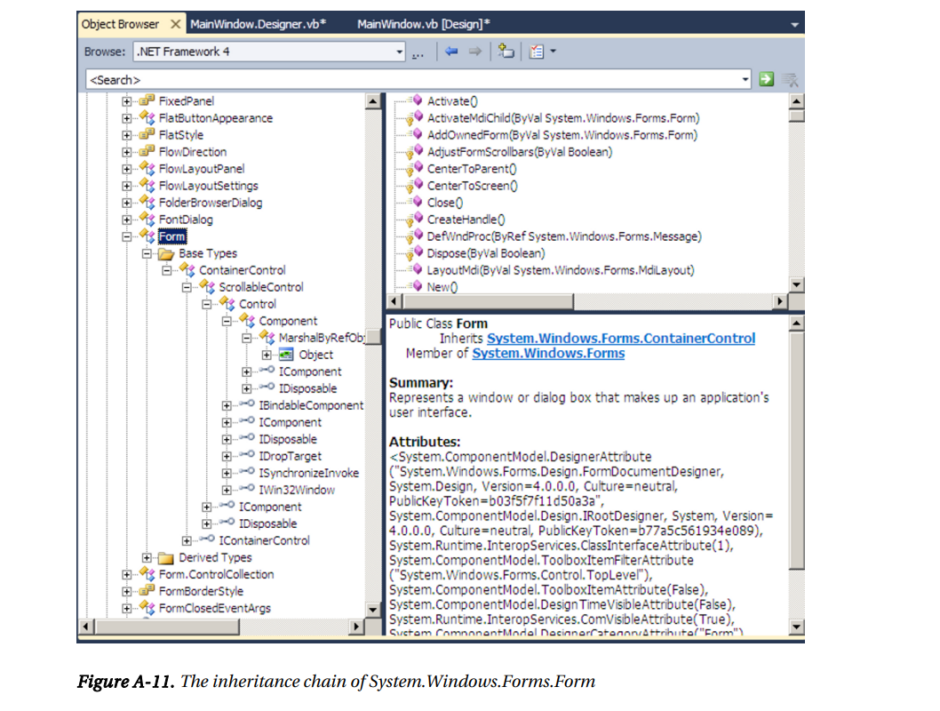

Slide 36
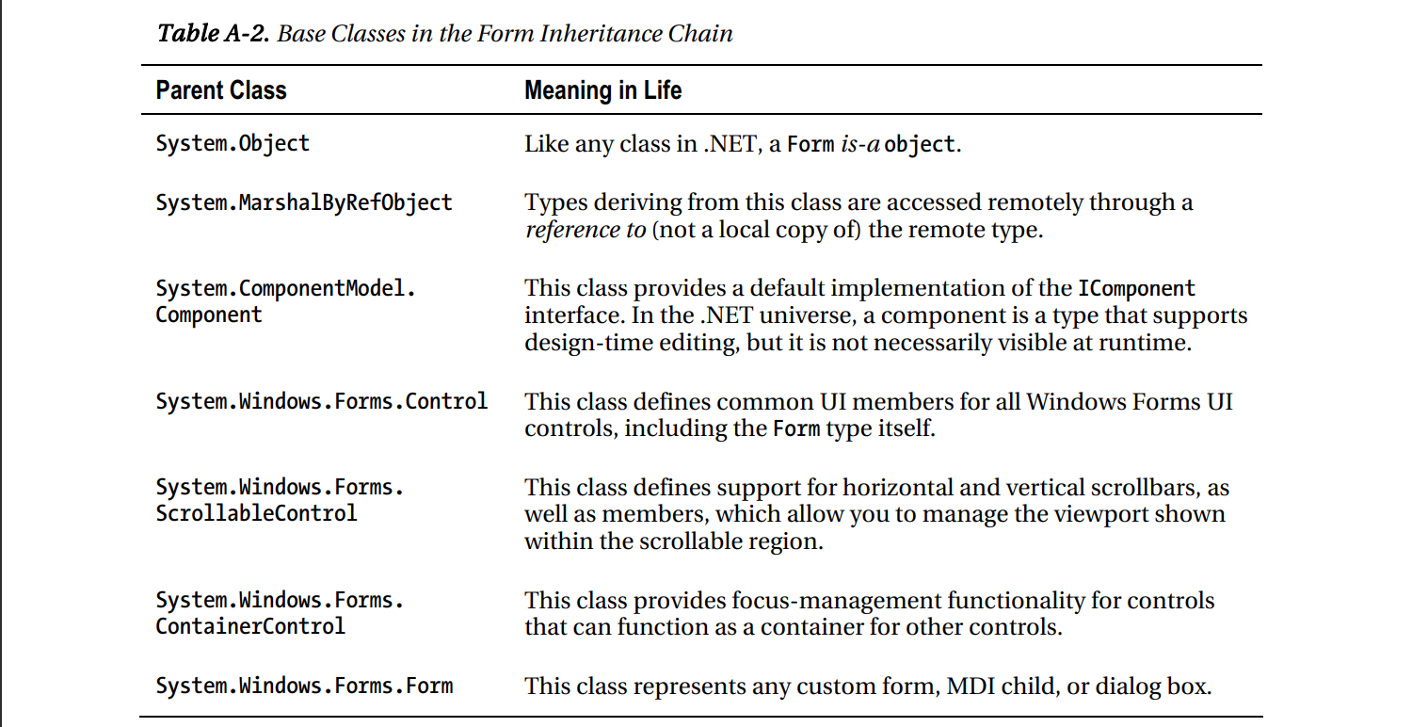

Slide 37
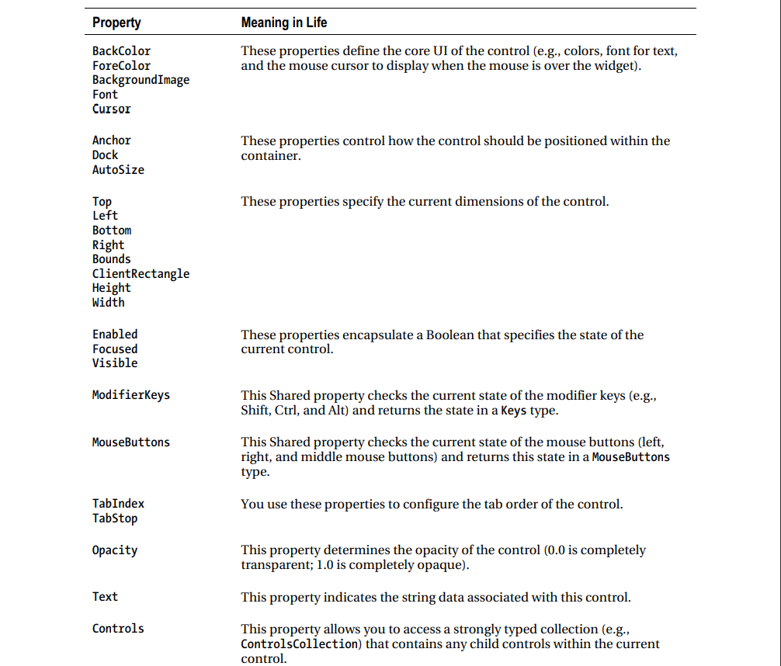
Core Properties of the Control Type

Slide 38
Window Form Events
Add code to respond to events, like button clicks
From the Properties window, select the lightening bolt (Events)
Double-click on the event name to generate code
Registers the event as being of interest
Adds a heading for event-handler method

Slide 39
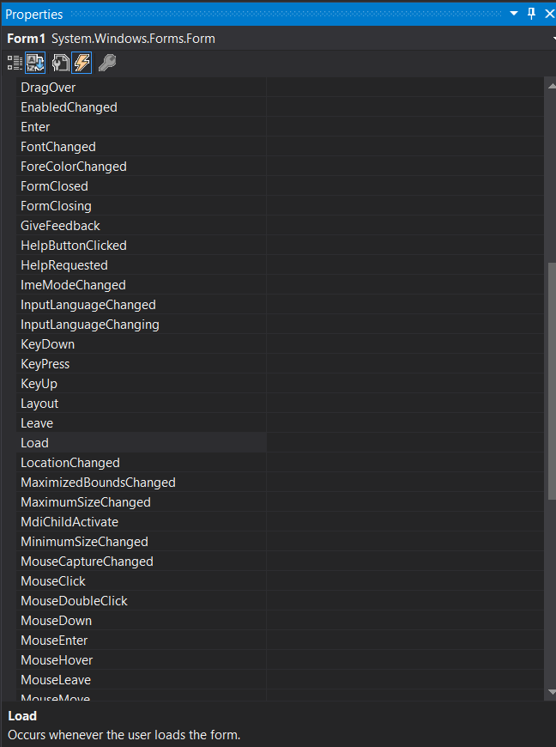
Window Form Events
Events button selected

Slide 40
Window Form Important Events
Name | Description
Activated | Occurs when the form is activated in code or by the user.
Click | Occurs when the control is clicked.
Closed | Occurs when the form is closed.
Closing | Occurs when the form is closing.
DoubleClick | Occurs when the control is double-clicked.
DragDrop | Occurs when a drag-and-drop operation is completed.
DragEnter | Occurs when an object is dragged into the control's bounds.
DragLeave | Occurs when an object is dragged out of the control's bounds.
DragOver | Occurs when an object is dragged over the control's bounds.
FormClosed | Occurs after the form is closed.
FormClosing | Occurs before the form is closed.
KeyDown | Occurs when a key is pressed while the control has focus.
KeyPress | Occurs when a key is pressed while the control has focus.

Slide 41
Window Form Important Events
Name | Description
KeyUp | Occurs when a key is released while the control has focus.
Load | Occurs before a form is displayed for the first time.
MouseClick | Occurs when the control is clicked by the mouse.
MouseDoubleClick | Occurs when the control is double clicked by the mouse.
MouseDown | Occurs when the mouse pointer is over the control and a mouse button is pressed.
MouseEnter | Occurs when the mouse pointer enters the control.
MouseHover | Occurs when the mouse pointer rests on the control.
MouseLeave | Occurs when the mouse pointer leaves the control.
MouseMove | Occurs when the mouse pointer is moved over the control.
MouseUp | Occurs when the mouse pointer is over the control and a mouse button is released.
MouseWheel | Occurs when the mouse wheel moves while the control has focus.
Paint | Occurs when the control is redrawn.
Resize | Occurs when the control is resized.
SizeChanged | Occurs when the Size property value changes.

Slide 42
Window Form Methods
Actions you can perform on a form:
Activate: give this form the focus
Close: close & release associated resources
Hide: hide, but retain resources to show form later
Refresh: redraw
Show: make form visible on the screen, & activate
ShowDialog: show modally
form.Hide();
.
.
.
form.Show();

Slide 43
Event Handling in Window Form
Event Handling:
Event handling is familiar to any developer who has programmed graphical user interfaces (GUI). When a user interacts with a GUI control (e.g., clicking a button on a form), one or more methods are executed in response to the above event.
Events can also be generated without user interactions. Event handlers are methods in an object that are executed in response to some events occurring in the application. To understand the event handling model of .Net framework, we need to understand the concept of delegate.

Slide 44
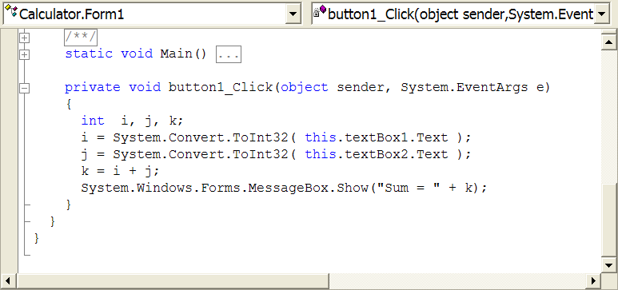
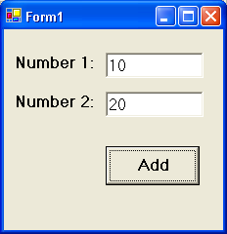
Event Handling in Window Form
Events are handled by methods that live behind visual interface
known as "code-behind"
our job is to program these methods…

Slide 45
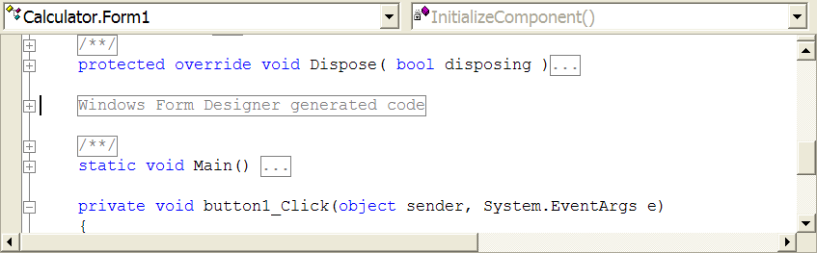
Event Handling in Window Form
Call-backs
Events are a call from object back to us…
How is connection made?
setup by code auto-generated by Visual Studio

Slide 46
Delegates in C#
A delegate in C# allows you to pass methods of one class to objects of other classes that can call those methods. You can pass method m in Class A, wrapped in a delegate, to class B and Class B will be able to call method m in class A.
You can pass both static and instance methods. This concept is familiar to C++ developers who have used function pointers to pass functions as parameters to other methods in the same class or in another class.
C# delegates are implemented in .Net framework as a class derived from System.Delegate.

Slide 47
Name Property:
The Name property is a string used by clients to identify, find, or announce an object for the user. All objects support the Name property.
For example, the text on a button control is its name, while the name for a list box or edit control is the static text that immediately precedes the control in the tabbing order. Even graphic objects that do not display a name provide text when queried for the Name property.
Delegating Requests
If an object does not have access to its Name property, it delegates requests to its parent, identifying itself by its child ID. For example, if a client calls an edit control's Name property, the edit control delegates the query to its parent, which returns the value of the static text control that labels the edit control.

Slide 48
Use of delegate involves four steps:
Declare a delegate object with a signature that exactly matches the method signature that you
are trying to encapsulate.
Define all the methods whose signatures match the signature of the delegate object that you
have defined in step 1.
Create delegate object and plug in the methods that you want to encapsulate.
Call the encapsulated methods through the delegate object.

Slide 49
The System.EventHandler Delegate
The ApplicationExit event works in conjunction with the System.EventHandler delegate. This delegate must point to subroutines that conform to the following signature:
Sub MyEventHandler(ByVal sender As Object, ByVal args As EventArgs) System.EventHandler is the most primitive delegate used to handle events within Windows Forms, but many variations do exist for other events.
As far as EventHandler is concerned, the first parameter of the assigned method is of type System.Object, which represents the object sending the event (the form itself in this case). The second EventArgs parameter contains any relevant information regarding the current event.

Slide 50
The class MyEventArgs is derived from the class EventArgs.
EventArgs is the base class of more specialized classes, like MouseEventArgs,
ListChangedEventArgs, etc.
For GUI event, you can use objects of these specialized EventArgs classes without creating your own specialized EventArgs classes. However, for non GUI event, you need to create your own specialized EventArgs class to hold your data that you want to pass to the delegate object.
public class MyEventArgs : EventArgs
{
public string m_myEventArgumentdata;
}

Slide 51
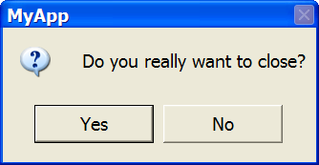
Form Events Example:
Ask user before closing form:
private void Form1_Closing(object sender,System.ComponentModel.CancelEventArgs e)
{
DialogResult r;
r = MessageBox.Show("Do you really want to close?",
"MyApp",
MessageBoxButtons.YesNo,
MessageBoxIcon.Question,
MessageBoxDefaultButton.Button1);
if (r == DialogResult.No)
e.Cancel = true;
}

Slide 52
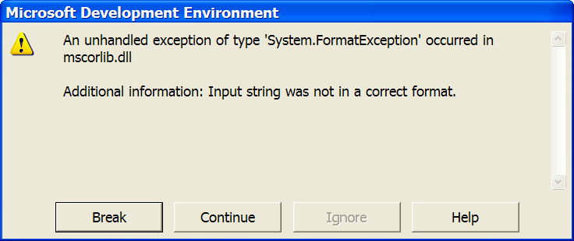
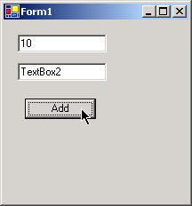
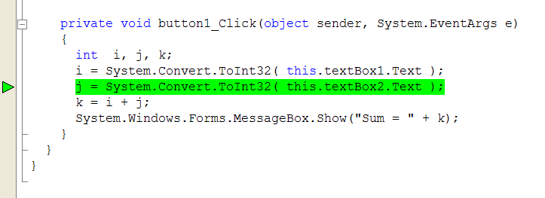
Break Mode:
Easily triggered in this application via invalid input.

Slide 53
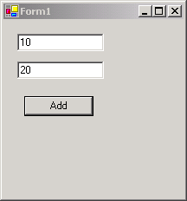
Abstraction:
FCL acts as a layer of abstraction
separates WinForm app from underlying platform
instance of
FCL class
System.Windows.Forms.Form
object
CLR
Windows OS

Slide 54
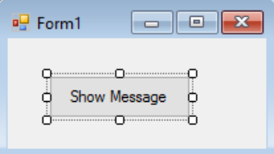
Basic Controls
Button
Buttons are one of the simplest controls and mostly used for executing some code when the user wants.
Here we have a really simple case, show a Message box when a button is clicked. We add a button to a form, name it showMsg as used in code to identify the object and set the buttons text to Show Message.

Slide 55
Basic Controls (Mostly used)
Button
Buttons are one of the simplest controls and mostly used for executing some code when the user wants.
Here we have a really simple case, show a Message box when a button is clicked. We add a button to a form, name it cmdShowMessage as used in code to identify the object and set the buttons text to Show Message.
TextBox
TextBoxes allow the user to input data into the program. We are going to modify the form and add a textbox so the messagebox show us the message that the user wants.

Slide 56
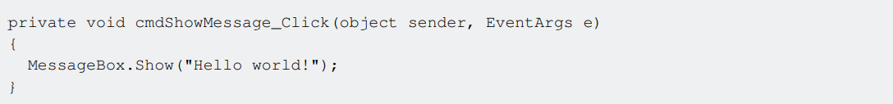
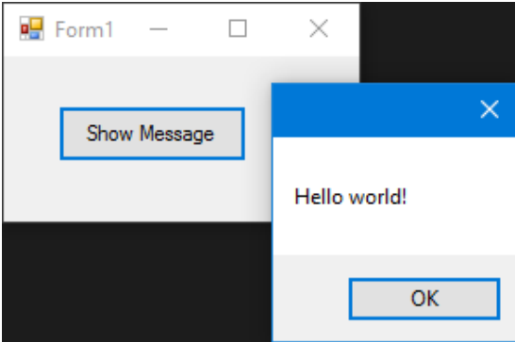
Double-click the button to add an event handler for the Click event. The Code Editor will open with the insertion point placed within the event handler function. Form.cs* file
The first parameter (sender) in the above declaration specifies the object that fired the event.
The second parameter (e) of the above declaration holds data that can be used in the event handler.
If we run the program now and click the button
we'll see the message appearing:

Slide 57
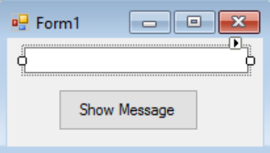
How to get Text from Text box?
We Add textbox in form.
Now user can Enter some text in textbox while user click on Show Message button the dialog box will show a text entered by user in the textbox.

Slide 58
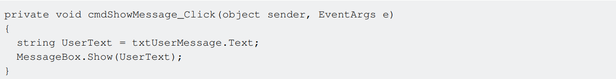
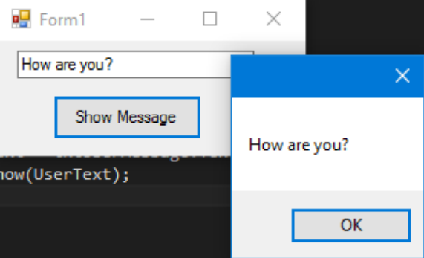
As you can see we are using the .Text property of the Textbox that is the text contained in the texbox. If we run the program, we will be able to write in the textbox. When we click the button the MessageBox will show the text that we have wrote:

Slide 59
ComboBox
ComboBoxes allow the user to choose one of various options provided by the developer. We are going to modify the form and add a combobox so the messagebox show us the message that the user want from a list that we will provide.
After adding the combo to the form we now add a list of options to the combo. To do so we need to modify the Items property:

Slide 60
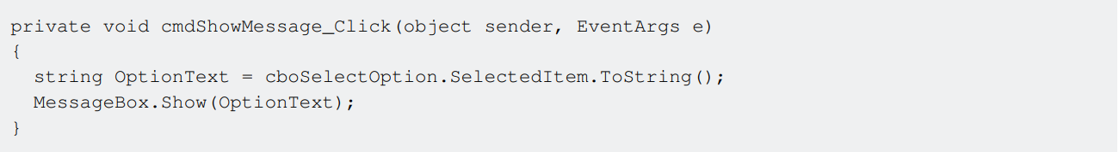
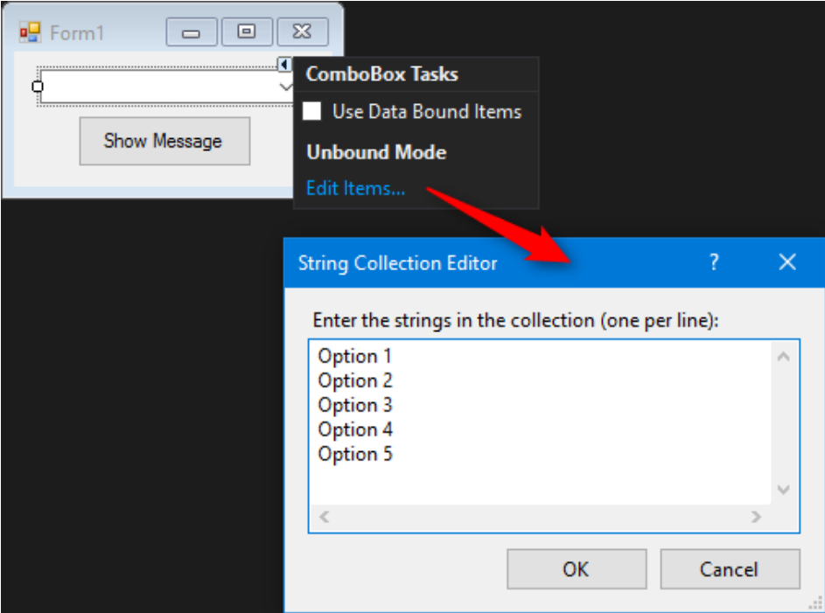
As you can see we use the SelectedItem property, it contains the object of the selected option.
Since we need a string to show and the compiler does not know if the object is or isn't a string, we need to use the ToString() method. If we run the program we'll be able to choose the option that we prefer and when we click the button the message box will show it:

Slide 61
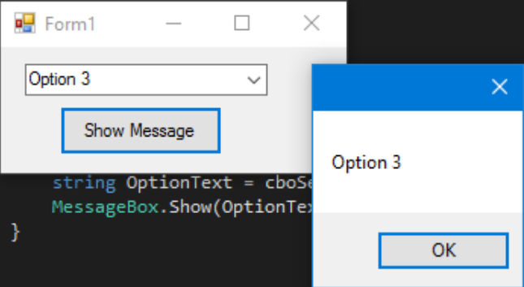
To be notified when an user selects an item from the combobox, use the SelectionChangeCommitted event.
We could use the SelectedIndexChanged event, but this is also raised when we programmatically change the select item in the combobox.

Slide 62
CheckBox
Checkbox is a control that allow user to get boolean values from user for a spesific question like "Are you ok?". Has a event called CheckedChanged, which occurs whenever the check property is changed. Here is a CheckBox that has a question "Is Checked?".
We got this MessageBox from CheckedChanged event,
If CheckBox is checked -> IsChecked variable will be true.
If CheckBox is not checked -> IsChecked variable will be false.

Slide 63
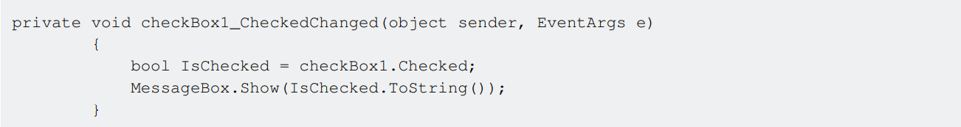
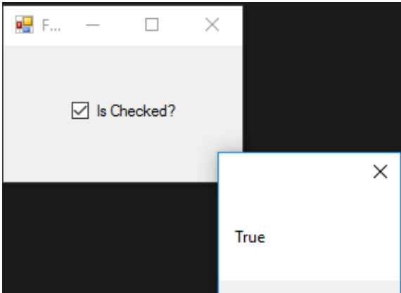

Slide 64
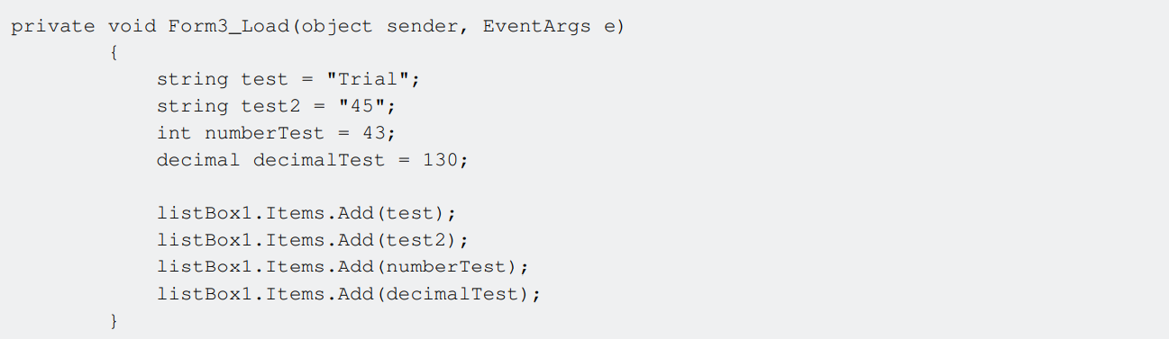
ListBox
Listbox is a control that can contains collection of objects.
Listbox is similar to Combobox but in Combobox; Only selected items are visible to user.
In Listbox; all items are visible to user.
How to add items to ListBox?

Slide 65

To be notified when an user selects an item from the combobox, use the SelectionChangeCommitted event.
We could use the SelectedIndexChanged event, but this is also raised when we programmatically change the select item in the combobox.

Slide 66
To be notified when an user selects an item from the combobox, use the SelectionChangeCommitted event.
We could use the SelectedIndexChanged event, but this is also raised when we programmatically change the select item in the combobox.

Slide 67
Timer
To execute a given code at regular intervals. (Normally we have to use threads and monitoring them to perform timer activity. No logic replaces the timer activity).
Example: digital Clock
Timer _ properties _ Enabled _ true
_Interval _ 1000 event _tick
Double click timer control and write the follow:
Code:
private void timerl_ Tick(object sender, Even tArgs e) {
labe12.Text = DateTime.Now.ToLongTimeString();
DateTime.Now.ToString("dd-m-yyyy
hh:mm:20");

Slide 68
Make a counter App:
Open Visual Studio.
Select Create a new project.
Select Window form App option.
Set project name i.e. counterApp and location and than press ok button to create a project.
After creating a project open toolbox:
Select Label for Application name:
In Properties:
Text: Counter App
Font: Change font size to 36

Slide 69
Now Select another label from Toolbar for output value the output value change while clicking
on particular button.
In properties:
Text: Counter App
Font: Change font size to 36
Select three buttons for Reset, Increment and Decrement counter.
In Properties:
Text: Reset
Name: resetbtn ( important property to represent or a function name for backend functionality perform)
Size: 100, 50

Slide 70


Slide 71

Counter App
We have three buttons reset, - button for decrement and + for increment value
We need a variable to store a value for counter.
int counter = 0;

Slide 72

Counter App

Slide 73

Counter App
Output:

Slide 74
Project 2: A Todo App
Open Visual Studio.
Select Create a new project.
Select Window form App option.
Set project name i.e. ListItem_store and location and than press ok button to create a project.
Design
After creating a project open toolbox:
Select Label for Application name:
In Properties:
Text: Fruit List
Font: Change font size to 36

Slide 75

Continue…
Setting Up the Form:
Click on form and go to form Properties window.
In Properties:
Start Position: Center Screen (to show form on Center of the Screen while running the app)
Text: List Items
Now Select Listbox from Toolbar to show list and drag it into form.
In properties:
Items: Click on collection to add item per line
Name: FruitList

Slide 76
Continue…
Selection Mode: Multi Simple (Select more than one item by pressing Ctrl button).
Now We have to add Items in list box dynamically so we need one label, one text box and a button.
Go to tool box Select a Label.
In Properties:
Text: Add Items
Font: 16px, Bold

Slide 77

Continue…
Again Go to tool box Select a Textbox.
In Properties:
Name : inputItem
Font: 14px, Bold

Slide 78
Continue…
Again Go to tool box Select a Button.
In Properties:
Text: Add
Font: 14px, Bold
Back color : For Background color
Fore color : for Text color
Now the idea is simple the user write item in textbox we just need add item in text box after click on add Button.

Slide 79

Continue…
You can add function or event name and press enter or you can double click on button to go to Form.cs backend Programming for button event to add item on list button on button click.

Slide 80

Continue…
Backend Programming for Add Item:

Slide 81
Continue…
Now we need to add Another button for Count List box Items.
Button For Count Items:
In Properties:
Text: Count items
Font: 14px, Bold
Back color : For Background color
Fore color : for Text color

Slide 82


Continue…
Backend Programming for Count Item:
Before we need to apply button click event or a function name:

Slide 83
Continue…
Now We can sort the List box Item in Alphabetic Order we need another button to sort item:
Button For Sort Items:
In Properties:
Text: Sort items
Font: 14px, Bold
Back color : For Background color
Fore color : for Text color

Slide 84


Continue…
Backend Programming for Sort Items function:

Slide 85
Continue…
Button for Remove Specific Items:
In Properties:
Text: Remove Specific Items
Font: 14px, Bold
Back color : For Background color
Fore color : for Text color

Slide 86


Continue…
Backend Programming for Removing Specific Item from list box:

Slide 87
Continue…
The last Button we are creating for Clear All List items from Listbox:
In Properties:
Text: Clear List
Font: 14px, Bold
Back color : For Background color
Fore color : for Text color

Slide 88


Continue…
Backend Programming for Clear all Items from list box:

Slide 89

Continue…
Output:

Slide 90

Picture viewer Windows Forms app Project
Open Visual Studio.
On the menu bar, selectFile > New > Project.
. On the left side of the New Project dialog box,
select either Visual C# or Visual Basic, and
then select Windows Desktop.
In the project templates list, select Windows Forms App
(.NET Framework). Name the new form Picture Viewer
,and then select OK.

Slide 91
Continue..
Layout Design:
Select Form:
In Properties Window:
Text: Picture Viewer (Enter Picture Viewer value and press enter to set Form name)
Select the form, again. Select the form's lower-right drag handle.
Drag the handle to resize the form so the form is wider and a bit taller. If you look at the Properties window, the Size property has changed. You can also change the size of the form by changing the Size property

Slide 92


Continue..
Select the Toolbox tab:
Select the small triangle symbol next to Containers to open the group.
Double-click TableLayoutPanel in the Toolbox.
You can also drag a control from the toolbox onto the form.
The TableLayoutPanel control appears in your form.

Slide 93

Continue..
Select theTableLayoutPanel then go to Properties Window.
Find the Dock property, which has the value None.
Select the dropdown arrow and then selectFill, which is the
large button in the middle of the dropdown menu.
Docking refers to how a window is attached to another window or area.
TheTableLayoutPanel now fills the entire form. If you resize the form
again, theTableLayoutPanel stays docked, and resizes itself to fit.

Slide 94


Continue..
In the form, select theTableLayoutPanel. In the upper-right corner, there's a small black triangle button. Select the triangle to display the control's task list.
Select Edit Rows and Columns.
Select Column1 and set its size to 15 percent. Be sure the Percent
button is selected.
Select Column2 and set it to 85 percent.

Slide 95

Continue..
From Show at the top of the Column and Row Styles dialog box, select Rows. Set Row1 to 90 percent and Row2 to 10 percent. Select OK to save your changes.
TableLayoutPanel now has a large top row, a small bottom row, a small left column, and a large right column.

Slide 96

Continue..
Add UI controls to the picture viewer App:
Select theTableLayoutPanel then go to Toolbox tab.
Double-click PictureBox to add a PictureBox control to your form.
Choose the new PictureBox control to select it, and then select the black
triangle on the new PictureBox control to display its task list.
Select Dock in Parent Container, which sets the PictureBox Dock property to Fill.

Slide 97

Continue..
In the Properties window for the PictureBox, set the ColumnSpan property to 2.The PictureBox now fills both columns.
Set the BorderStyle property to Fixed3D.
Select TableLayoutPanel. Go to Toolbox tab, double-click the CheckBox item to add a new CheckBox control.
Choose the Text property and enter Stretch.

Slide 98
Continue..
Add buttons in a layout panel.
Select theTableLayoutPanel on the form. Open the Toolbox, Select Containers. Double-click FlowLayoutPanel to add a new control to the last cell of theTableLayoutPanel.
Set the FlowLayoutPanel's Dock property to Fill. You can set this property by selecting the black triangle, then selecting Dock in parent container.
A FlowLayoutPanel is a container that arranges other controls in a row, one after another.
Select the new FlowLayoutPanel and open the Toolbox and select Common Controls. Double-click the Button item to add a button control called button1.

Slide 99
Continue..
Double-click Button again to add another button. The IDE calls the next one button2.
Add two more buttons this way button3 and button4.
Select the first button and set its Text property to Show a picture.
Set the Text properties of the next three buttons to Clear the picture, Set the background color, and Close.
and Set Name property to all of the buttons closeButton, backgroundButton,clearButton,and showButton.
To size the buttons and arrange them, select the FlowLayoutPanel. Set the FlowDirection property to RightToLeft.
Choose the Close button to select it. Then, to choose the rest of the buttons at the sametime, press and hold the Ctrl key and choose them, too. 10. In the Properties window, set the AutoSize property to True. The buttons resize to fit their text.

Slide 100
Continue..
Add dialog components:
Unlike a control, adding a component to your form doesn't add a visible item. Instead, it provides certain behaviors that you can trigger with code. For instance, it's a component that opens an Open File dialog box.
Open the Toolbox and select the Dialogs group.
Double-click OpenFileDialog to add a component called openFileDialog1 to your form.

Slide 101

Continue..
Double-click ColorDialog to add a component called colorDialog1. The components appear at the bottom of Windows Forms Designer as icons.
Choose the openFileDialog1 icon and set two properties:
Set the Title property to the following:
Select a picture file The Filter property settings specify the types that the Select a picture dialog box displays.

Slide 102
Continue..
Add backend code to the picture viewer App:
Add event handlers for your controls:
In the Windows Forms Designer, double-click the Show a picture button. You can instead select the Show a picture button on the form, and then press Enter. Or Set click Event name and press Enter.

Slide 103

Continue..
Backend code for Show Picture Button:

Slide 104

Continue..
Backend code for Clear the Picture Button:

Slide 105

Continue..
Backend code for Set Background color Button:

Slide 106

Continue..
Backend code for close Button to close the Application:

Slide 107

Continue..
Backend code for Stretch the image while check box is Check:

Slide 108

Continue..
Output:

Slide 109
Class Task:
Make a Calculator Application
Make a Quiz Application

